Slide 1
Grammar Generation for Self-Organizing Robotic Systems
Lizzy Presland
UW Bothell CSSE
June 12, 2020
Sponsor: Dr. Mann, Mathematics
Advisor: Dr. Stiber, CSSE

Slide 2
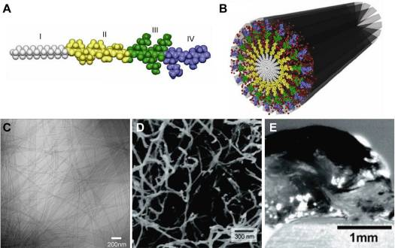
Biological Systems
Peptide amphiphile molecule and assembled nanotube.
Notes:
Self-assembling biomolecular structures exist and can be found in the following systems and many others:
Assembly of ribosomes, which creates proteins in living cells
Protein folding
Formation of receptor rafts for signaling on cell membranes
Alignment of muscle fibers over macroscopic length scales
Reversible filaments of the cytoskeleton
Image A is an image of a single canonical peptide amphiphile. Image B is a carbon nanotube assembly of PA molecules.
The PAs were developed in the 1990s and the early 2000s and could be used in various medical areas including: nanocarriers, nanodrugs, and imaging agents. However, perhaps their main potential is in regenerative medicine to culture and deliver cells and growth factors.

Slide 3
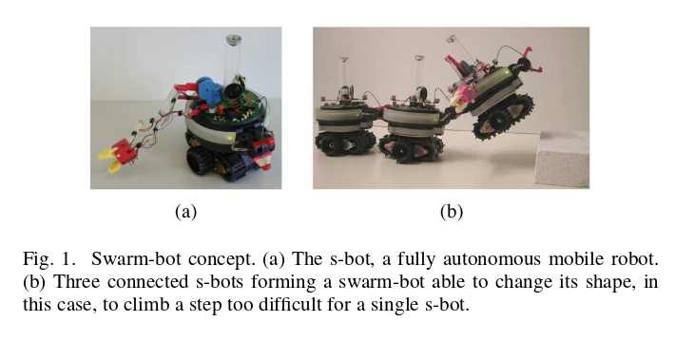
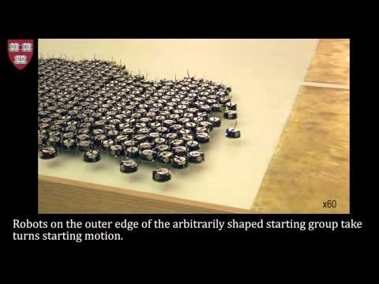
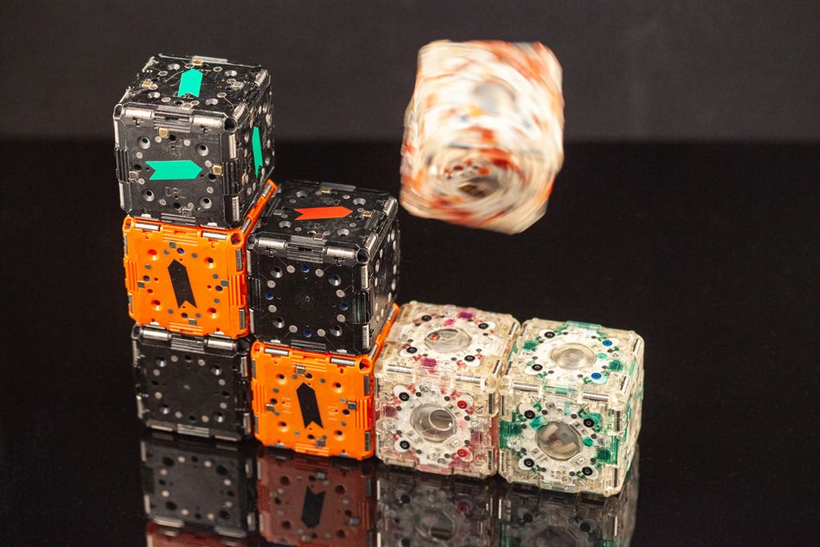
Robotic Systems
Notes:
In robotics, self-governing machines (or nodes) can create adaptable and flexible systems for navigation, exploration, communications.
Weather systems
Space exploration
Deep sea exploration
Figures in middle: swarm-bot concept from Roderich Groß’s paper.
A): the s-bot, a fully autonomous mobile robot
B): three connected s-bots forming a swarm-bot which is able to change shape. In this case, the sbots are linked linearly to assist each other climbing over steps by pushing/pulling while on stable ground
Video: HARVARD experiments with self-assembling robots
Still on left: MIT CSAIL’s M-Cube project

Slide 4
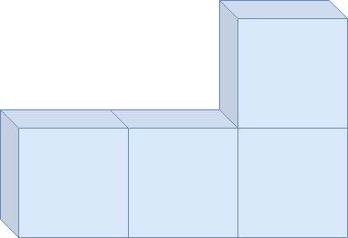
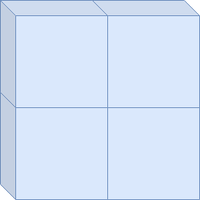

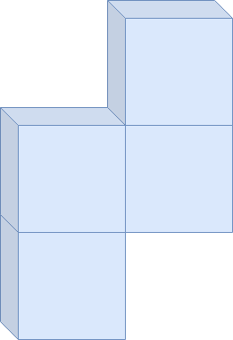

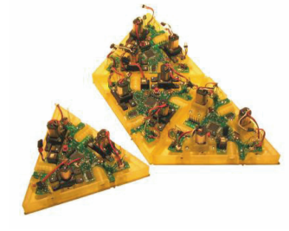
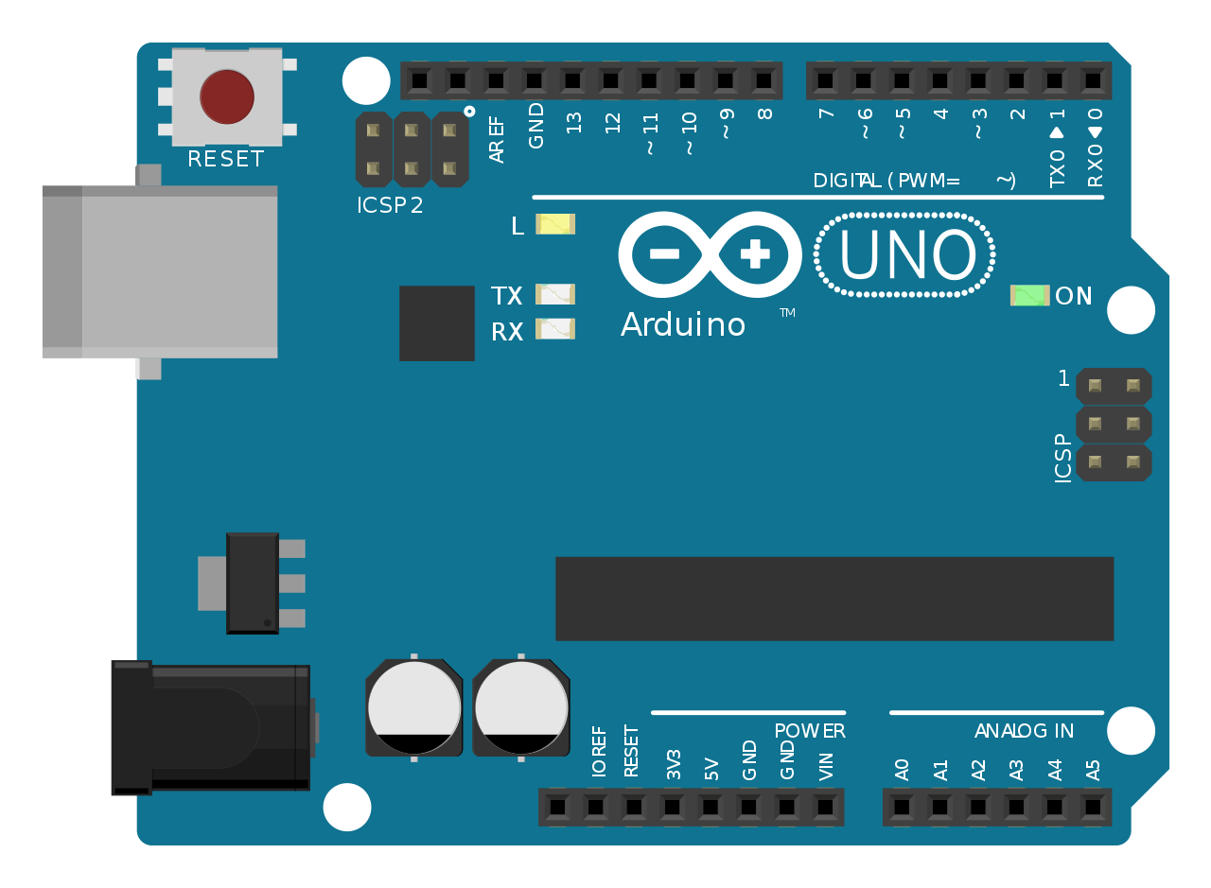
Project Focus
Notes:
We focused on the work of Eric Klavins (UW Seattle Electrical Engineering) and his colleagues.
This author group focuses on representing target formations as graphs, and assembly processes as graph grammars. These concepts are excellent models for physical configurations of programmable devices; each device is a node, and each internode connection is a graph edge.
Two papers were of particular interest, and they respectively summarized as:
A theorized algorithm to generate assembly rules which may produce a single target configuration.
A practical experiment showing the behavior of a rule system which assembles two dimensional triangular nodes into a hexagon.
However, there were no examples of software which programmatically produced a rule system.

Slide 5
Project Goals
Generate rule set for a target graph
Produce Arduino sketches which enforce assembly rules in a system
Demonstrate with Arduinos
Notes:
There are 3 core deliverables in this project.
Create an application which generates an assembly rulesystem for a target structure.
From the rules produced in Step 1, produce an Arduino-compatible code file for a programmable Arduino node in a system.
Demonstrate this system works as intended using 2 physical Arduino boards.

Slide 6
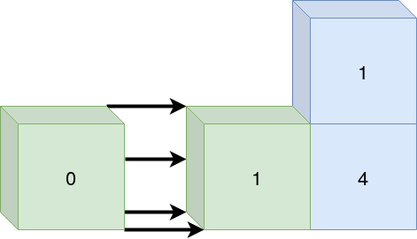
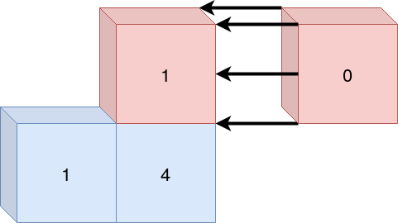
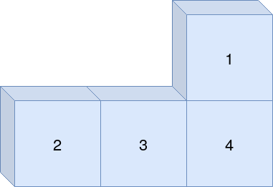
Graph Grammars in 30 Seconds
Notes:
To codify a node’s role in the overall structure, we assign them labels.
A label represents the node’s current state, or the role in the substructure.
When something happens in the system (like two nodes attempt to fuse into a new substructure), there must be a way to validate if that configuration is legal for the target shape.
The valid configurations of substructures are codified in rules, which are invoked by assembly events.
A configuration might not be valid; if an event doesn’t have a corresponding rule describing the event, the involved nodes can act on that.
Together, a set of rules forms a graph grammar!

Slide 7
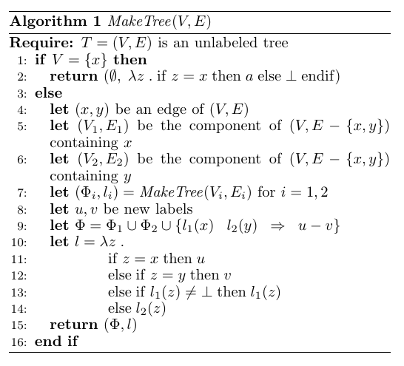
Algorithm Adaption
Problems reproducing expected graph grammars:
Repeated rules
Non-deterministic system state
Inconsistent properties in rulesets
Solution: invent a different algorithm!
Notes:
About halfway through the project, Dr. Mann and I agreed that instead of using the recursive strategy described in the literature we were referencing, we would design an iterative implementation.
Non-deterministic system state: multiple rules can be applied to a single node
Repeated rules
Ruleset properties do not obey described constraints: rule count, label count

Slide 8
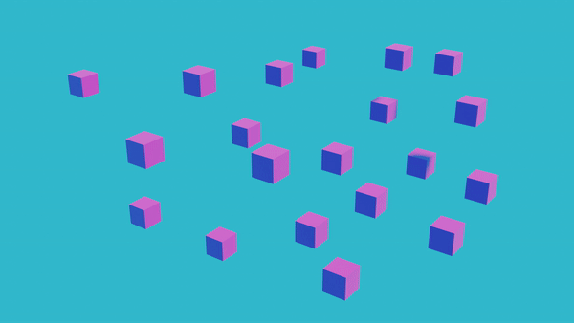
I naively thought I would be creating a rule generation system which behaves like this...
Notes:
Here, we see the assembly of a specific shape called a sierpinski cube. The shape is not important; the assembly pattern is what matters.
The key thing to note here is that multiple subsets of the target shape are assembled independently and in parallel. Each of the two pieces coming together can consist of structures which contain more than one individual node. In an implementation which would create such a pattern, there are rules which allow for two partially-assembled formations to connect.
Such a rule system is important to reduce the number of assembly steps required to assemble a shape. An assembly process which obeys the properties shown here would allow a structure to grow at an exponential rate. It would also allow greater flexibility in the location of individual nodes in an environment

Slide 9
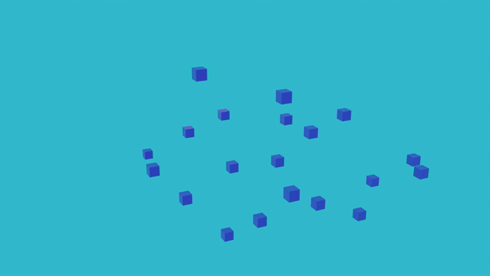
...but the rule generation system I created behaves like this.
Notes:
We contrast the previous slide with this assembly pattern. Here, only one node at a time can join the structure being built.

Slide 10
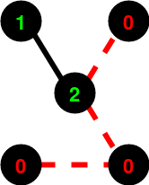
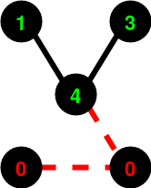
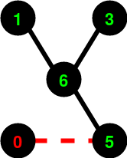
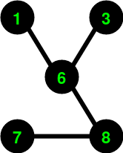
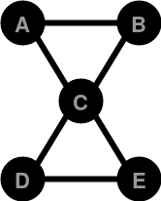
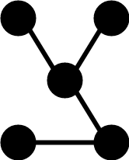
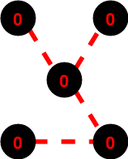
Writing the Application
Input (graph):
A*B
B*C
C*A
C*D
D*E
E*C
Output (rules):
++++
A:0 --> []
C:0 --> []
====
A:1 --> [C:2]
C:2 --> [A:1]
# etc
Notes:
The application which builds a graph grammar takes an ASCII representation of a graph as input and prints an ASCII representation of the derived ruleset as output.
It is written in C++.

Slide 11
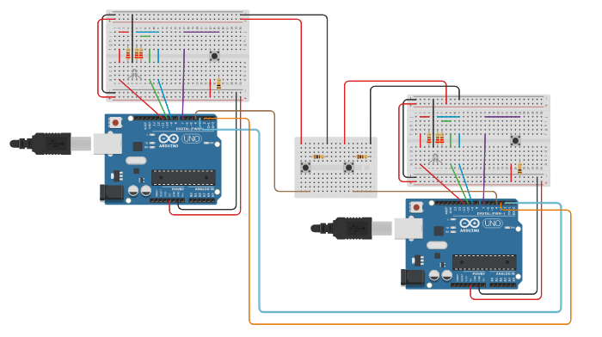
Arduino Prototype
++++
A:0 --> []
B:0 --> []
====
A:1 --> [B:2]
B:2 --> [A:1]
const uint8_t MAX_LABELS = 3;
const uint8_t labels[MAX_LABELS] = { 0, 1, 2, };
const int RULE_COUNT = 1;
rule ruleset[RULE_COUNT] = {
{ pairs: { { older: 0, newer: 1 },
{ older: 0, newer: 2 }, }, },
}; // rule is a struct
Notes:
A simplistic Arduino configuration was devised to simulate assembly events and show the state changes of individual nodes when assembly events occur.
Each board has an identical sketch uploaded to it.
Written and visual cues for output and input are included in the breadboarding configuration.
An assembly event is triggered manually using pushbuttons.
The rules for the programmable nodes must be accessible in a executable program for that device. So, for each new ruleset, a new program must be created.
To accomplish this, I wrote a code generator which parses the plain-text rule representation and encodes the rules and their associated labels in a predetermined data structure.

Slide 12
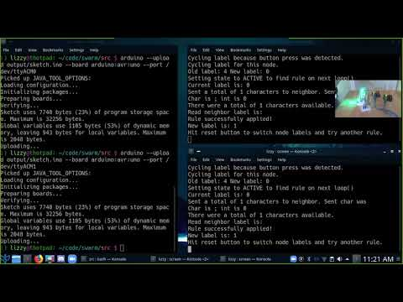
Results in Action
bit.ly/SwarmZoom
Notes:
This 1-minute clip shows the Arduino prototype in action. The miniature camera view shows the physical devices being used to simulate a connection event in a system.
The screen view shows the output of each Arduino, documenting events and device state.
Full video is available at https://bit.ly/SwarmZoom

Slide 13
Lessons Learned
Document everything
Dig deeper
Don’t be afraid
Ask for assistance
Say “I don’t know”
Don’t be disappointed
Smart pointers are magical
Notes:
Document your work and, more importantly, your thought processes as you go
Dig deeper into the concepts you don’t understand, even if it takes time to absorb the information
Don’t be disappointed when your goals shift to align with your needs, or when something doesn’t work the first 28 times you try it

Slide 14




Coursework and Tools
Related coursework:
CSS 301 (Technical Writing)
STMATH 300 (Foundations of Mathematics)
CSS 343 (Data Structures & Algorithms II)
CSS 390 (Scripting Languages)
Coursework I wish I had taken:
CSS 427 (Embedded Systems)
Advanced math courses

Slide 15


Many Thanks
Prof. Michael Stiber, UWB CSSE
Prof. Casey Mann, UWB Mathematics
Prof. Clark Musselman, UWB Mathematics
Friends and Family: Ryan, Madeline, Lauren, Richard, Joyce, Elle, Emily, Drew
Code: https://bit.ly/SwarmCode
Demo: https://bit.ly/SwarmZoom

